Slide 1


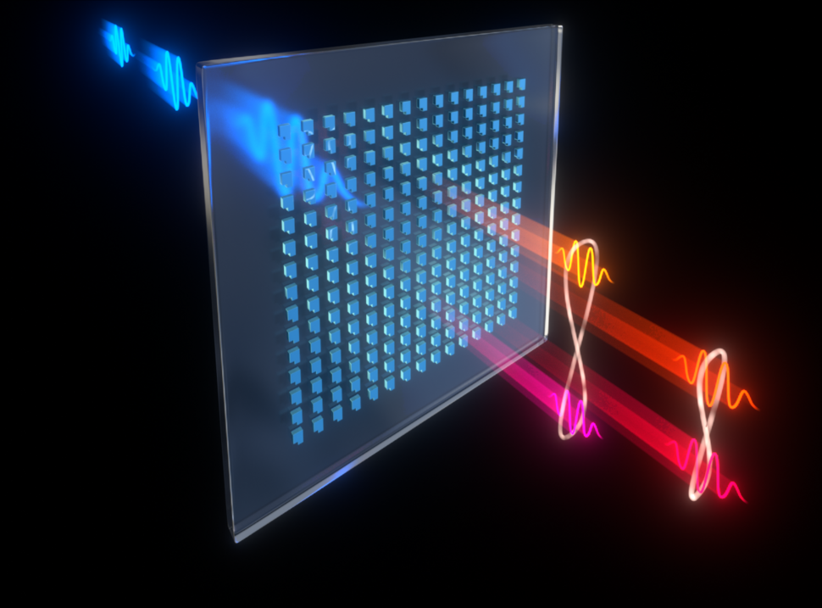
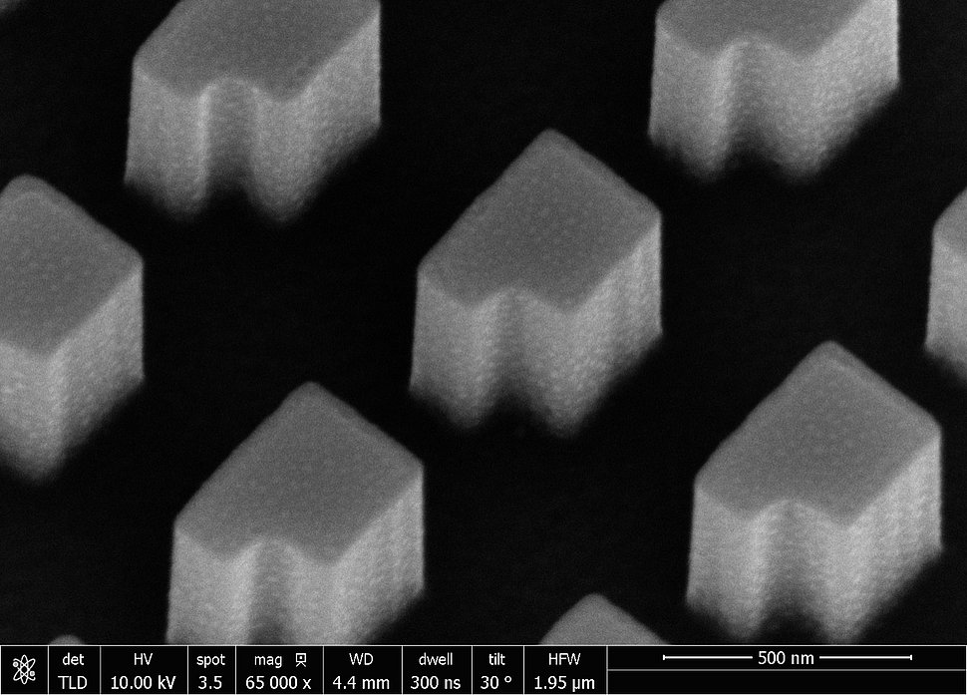
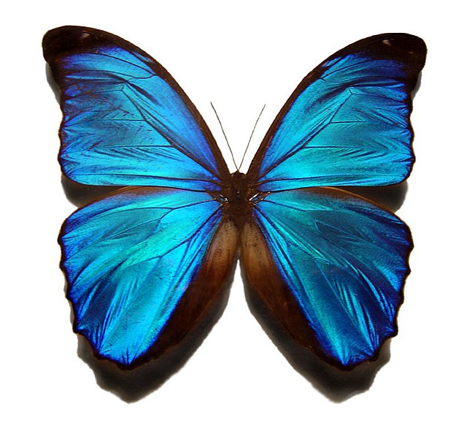
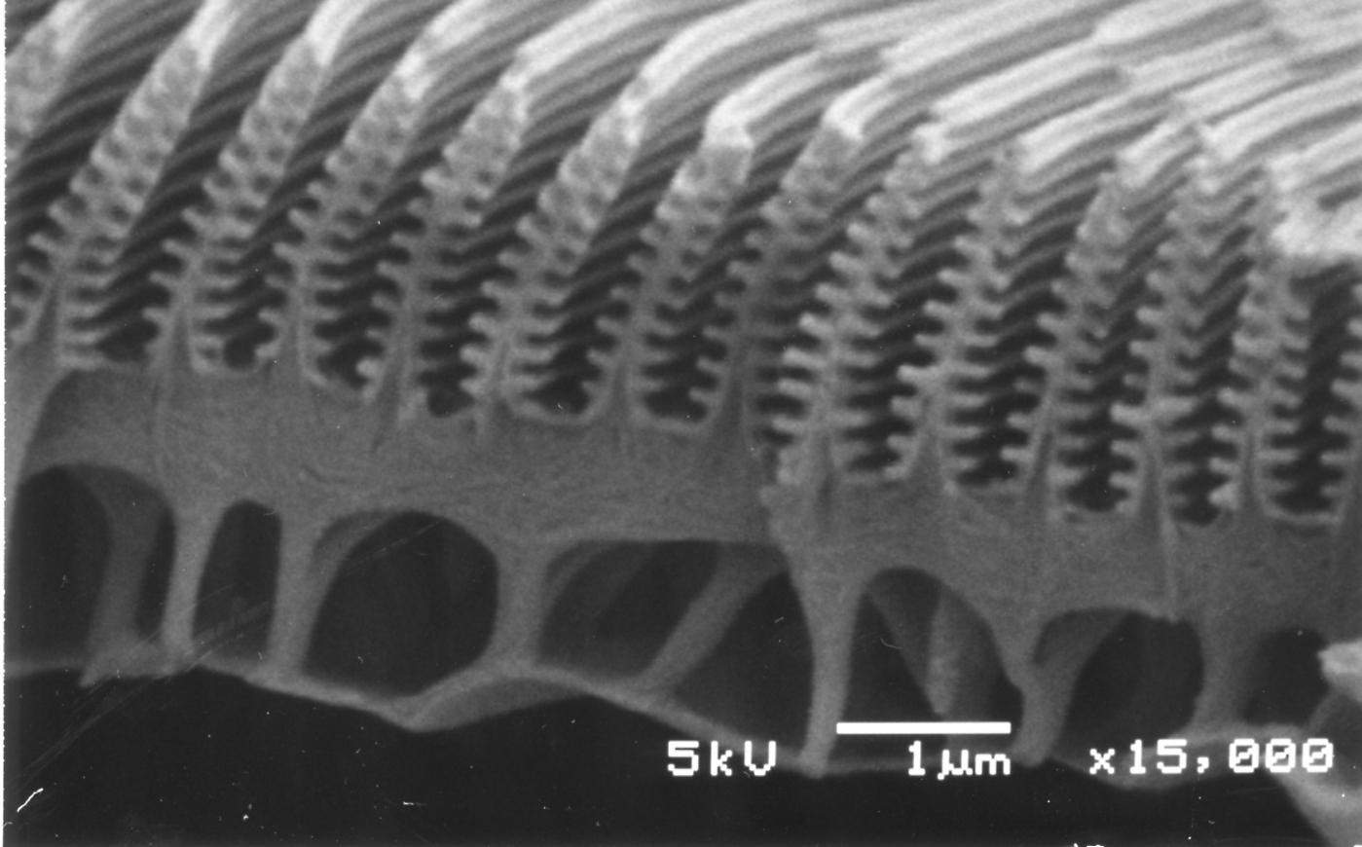

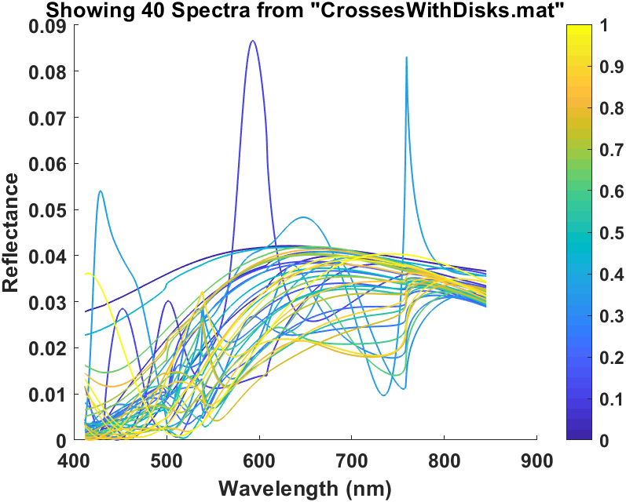
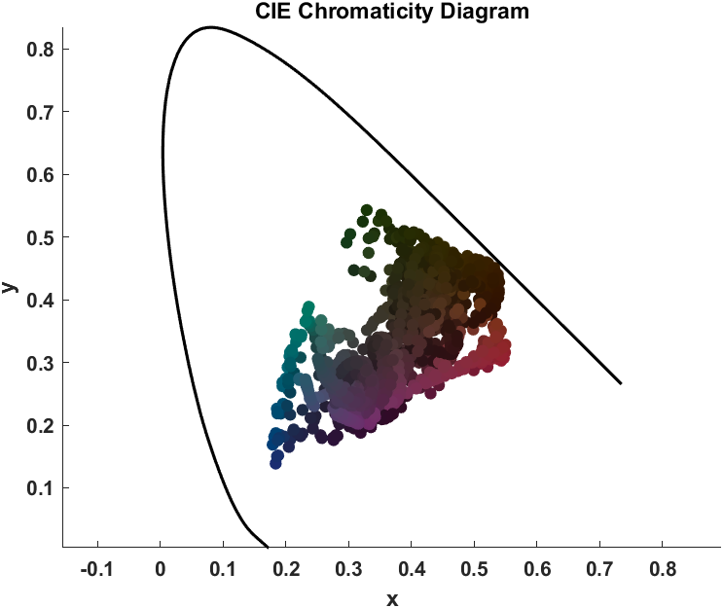
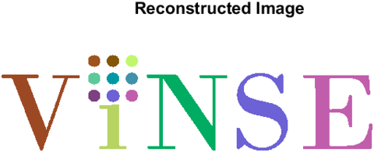
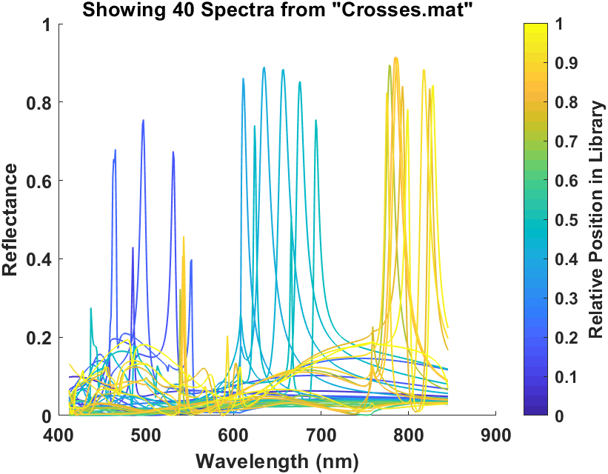
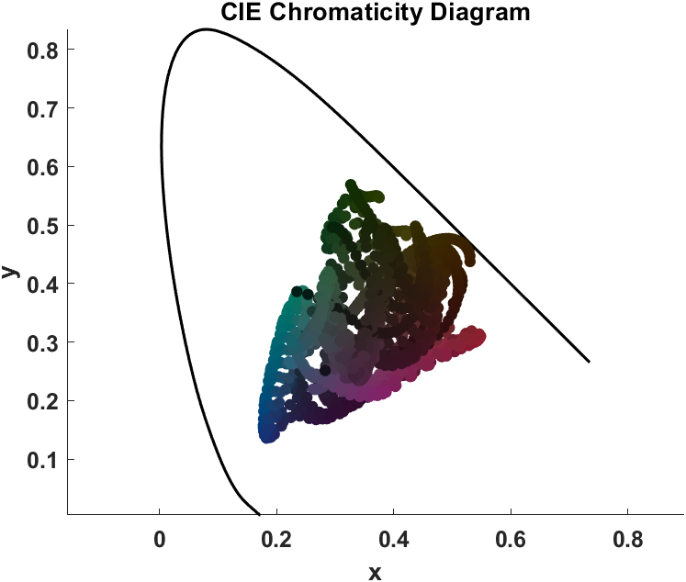
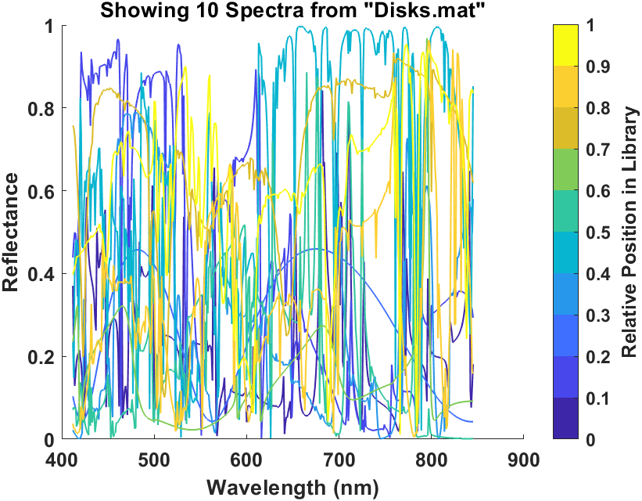
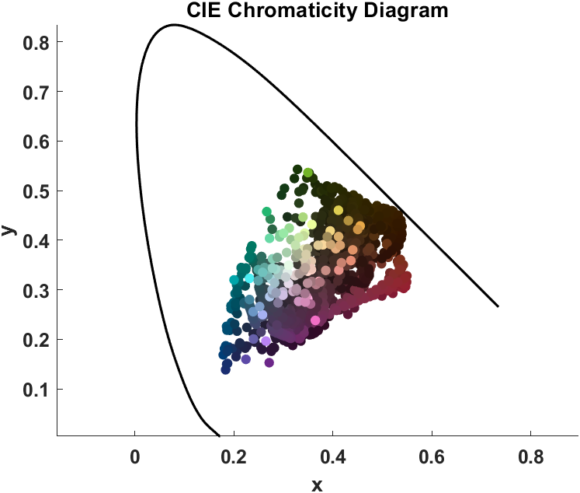
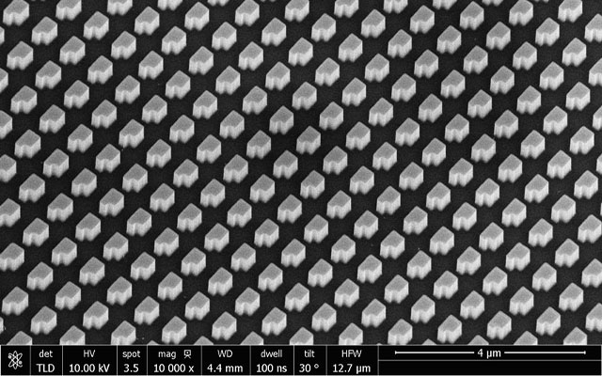
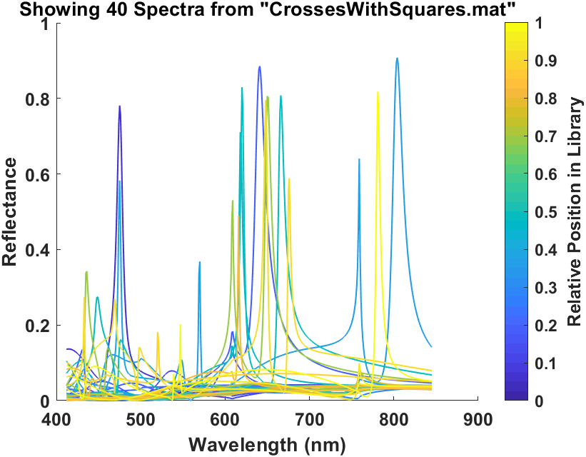
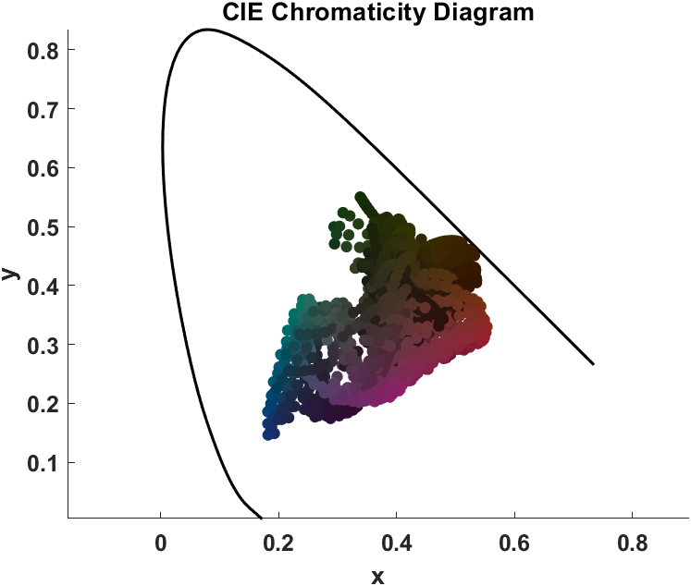
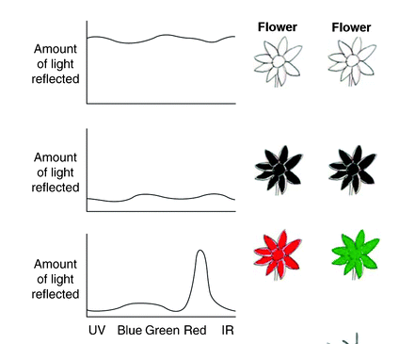

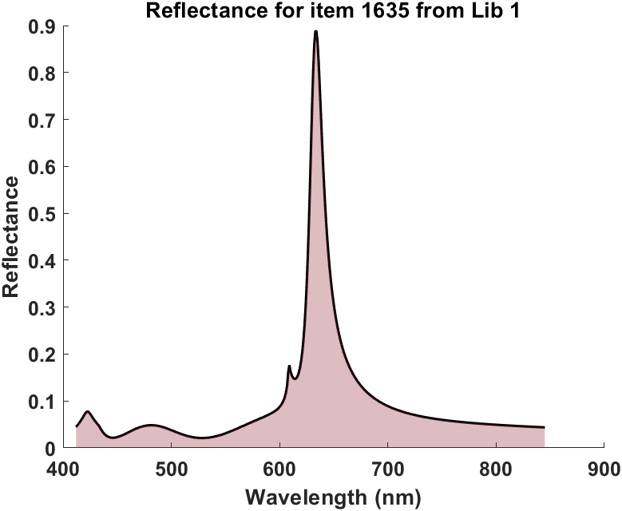

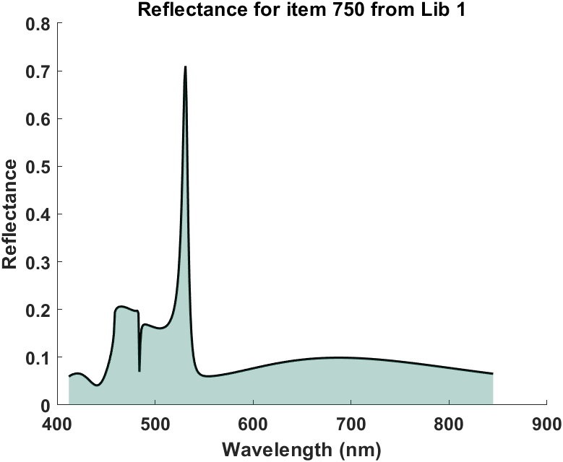
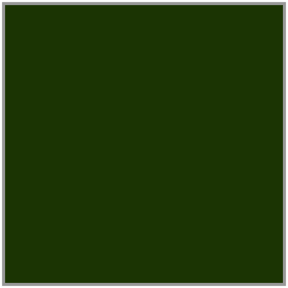

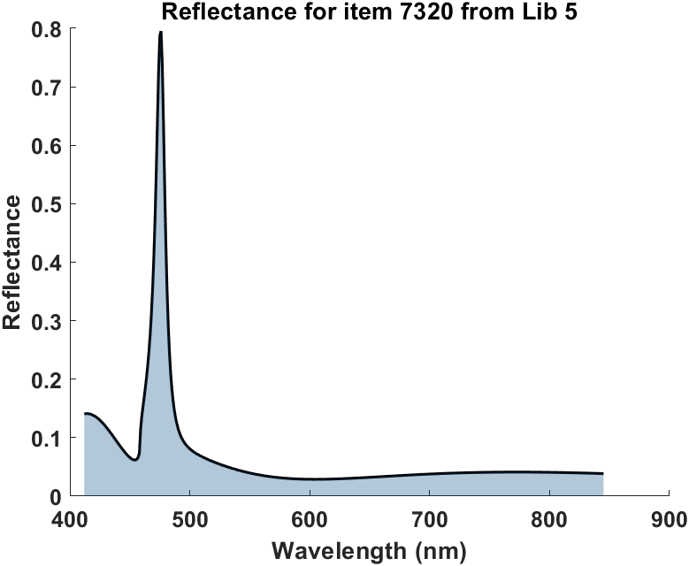

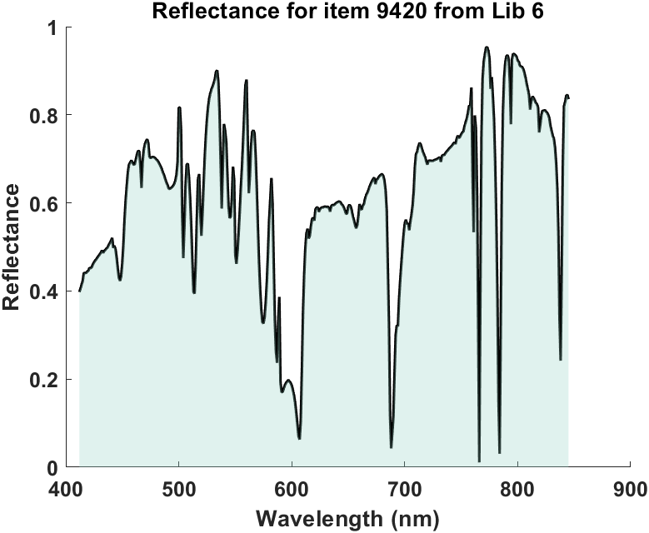

Geometry-driven Structural Color Control In Silicon-rich Nitride (SRN) Metasurfaces.
Winston Nfor Kanjo Ndi¹, Jason Valentine², Rahul³
^{1,2}Department of Mechanical Engineering, Vanderbilt University.
³Interdisciplinary Materials Science, Vanderbilt University.
Metasurfaces
Structural Colors
Simulating Nanophotonic Structures
Device Concept
Tool: Rigorous Coupled-Wave Analysis(RCWA), is a computational method used to determine how electromagnetic waves—like light—interact with periodic structures.
RGB Values were extracted from the image for all pixels.
Computation Results
Each extracted RGB value was mapped against the closest RGB gotten from the Library.
1
3
Cross With Disks
Device Fabrication Workflow
A metasurface is an ultra-thin, engineered material that uses nano-scale patterns to precisely manipulate light, enabling applications from creating flat lenses to producing vivid structural colors for advanced anti-counterfeiting.
Structural colors, unlike pigment-based hues, are produced by nanoscale structures whose geometry—not chemistry—creates colors, offering superior durability, tunability, and fade resistance, and are employed in applications ranging from anti-counterfeiting on banknotes to optical sensors.
a
b
c
SRN
Resist
Quartz
PECVD
Resist Coating
SRN
Cross
EBL Patterning
d
e
f
Cr Depo and Liftoff
RIE
SRN pillar
We used silicon-rich nitride (SRN) as the dielectric material for our metasurfaces because, unlike conventional dielectrics, SRN enables continuous tuning of both refractive index and extinction coefficient simply by adjusting the SiH₄:N₂ ratio during PECVD, providing unparalleled design flexibility for metasurface applications.
Disks
Cr Etch
g
h
i
Future Direction
How do we see colors?
Cross With Squares
j
k
l
Our next step is to fabricate the device featuring the VINSE logo (3). We expect to achieve a broader color palette by exploring new nanostructure geometries and optimizing SRN deposition recipes for enhanced optical properties.
White→High reflection across the visible spectrum
We simulated periodic arrays of four distinct nanostructure geometries using Rigorous Coupled-Wave Analysis (RCWA) (Fig. a, d, g, j). The resulting reflectance spectra were used to generate a comprehensive spectral library (Fig. b, e, h, k). To visualize the range of achievable colors, each spectrum from the library was then plotted as a point on a CIE chromaticity diagram (Fig. c, f, i, l). As shown, modifying the nanostructure geometry provides direct control over the achievable color gamut.
Black→Low reflection (high absorption) across the visible spectrum
References & Acknowledgements
Colored Object (e.g.,Red)→High reflection of specific wavelengths .
2
Structural colors in the library
Funding was provided by the SyBBure Searle Program. Sincere gratitude to my PI Jason Valentine, my mentor Rahul Shah, the VINSE staff and the entire valentine Lab members for their exceptional guidance and mentorship.
Some Geometries Explored
SRN
SiO₂
Tomás Santiago-Cruz et al., Science(2022)
Glover, B. J. and Whitney, H. M., Annals of Botany, Structural color and iridescence in plants: the poorly studied relations of pigment color, 105, 4, 505-511 (2010)
Reflectance Spectrum
Color Formed
Reflectance Spectrum
Color Formed

